Slide 1
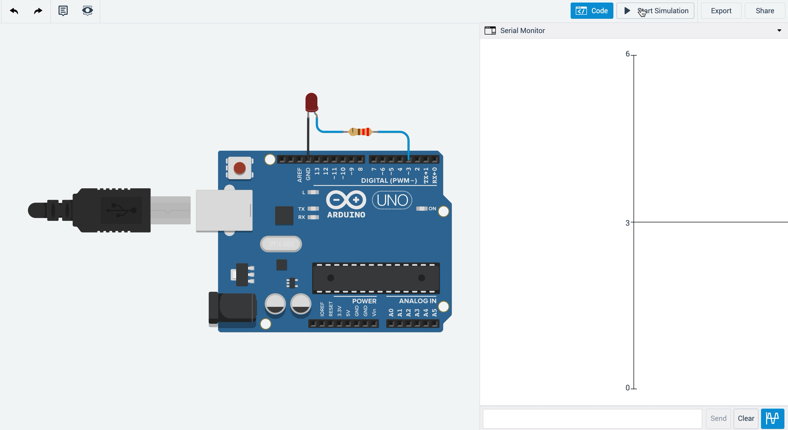
Pin 3 Output Voltage
Pin 3 Output Voltage Graph

